Slide 1
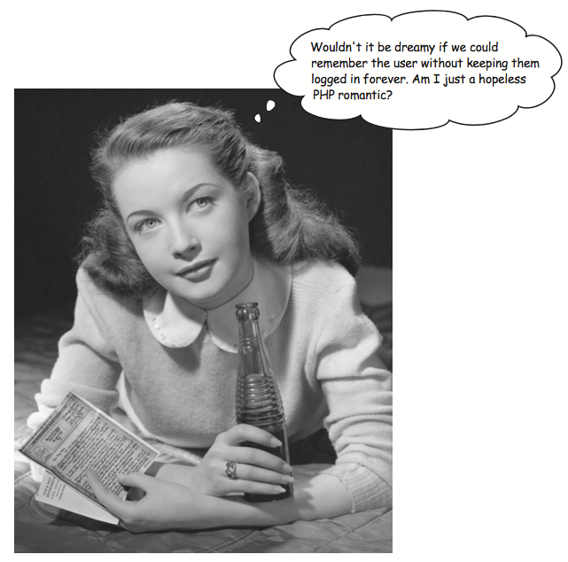
User Authentication

Slide 2
Files You Will Need
New to download from Canvas
session01.php
session02.php
session03.php
Existing in your contacts files
make a copy of authcookies.php and save it as authsessions.php
index.html
header.php
showcontacts.php

Slide 3
Introduction
Keeping track of users as they move around a website is known as a session tracking.
You will learn why session tracking is important.
You will learn how to use PHP’s built-in support for session tracking.

Slide 4
Objectives
Describe problems with using cookies as the only method of authentication.
Start a session and store a cookie with a session ID
Check the session settings for PHP on your web server
Use output buffering to control output sent to the browser
Define Session Hijacking and use techniques to prevent it
Use sessions to implement user authentication in the Contacts web app

Slide 5
Techniques to add State
Sessions and cookies
PHP uses a cookie to store a session ID.
The browser passes the cookie to the server with each request.

Slide 7
Cookie Problems
You used a login/out script based on cookies.
What if cookies are disabled? Users can control that in their browsers.
If cookies are disabled, then they couldn’t use your web application. Uggh!
Instead, we can use the server to store login data. That’s next!

Slide 8
Sessions
Data is stored on the server, not on the web browser.
Used to locate a particular user’s record (the session data)
More secure (data is retained on server).
Can store more data than cookies.
Can be used with and without cookies.
Session variables are automatically destroyed as soon as a session ends (logout or closing browser)

Slide 9
Setting Session Variables
Each page that uses a session must begin by calling the session_start() function.
It will tell PHP to start a new session or access an existing one.
This function must be called before anything is sent to the web browser.
This command should be called only once on a page.

Slide 10
session_start()
First time used it will attempt to send a cookie with:
PHPSESSID – the cookie name
32 hex letters – the cookie value
Once the session is started values can be registered to the session using array syntax: $SESSION[‘key’] = value; $SESSION[‘name’] = $username;

Slide 11
Life and Death of a Session
Begins when the session_start() function is called.
Creates a unique session identifier.
Ends
session_destroy()
browser closes

Slide 12
Sessions and Cookies
If the browser allows cookies, a session may set a cookie that temporarily stores the session ID.
Sessions are not entirely dependent on cookies.
Cookies serve as an optimization for preserving the session ID across multiple scripts.
If cookies are disabled, the session ID gets passed from script to script through a URL, similar to how you’ve seen data passed in a GET request.
The specifics of how sessions react in response to cookies being disabled are controlled in the php.ini configuration file on the web server via the session.
use_cookies, session.use_ only_cookies, and session. use_trans_sid settings

Slide 13
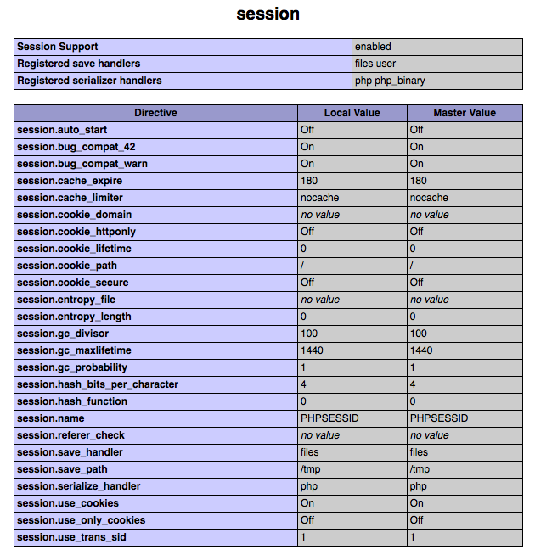

Slide 14
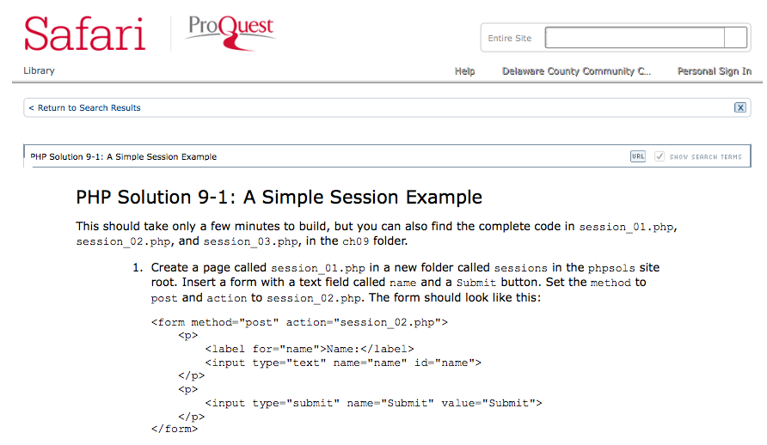
Simple Session Example.pdf
Source: (login to delagate first) http://proquestcombo.safaribooksonline.com.libdb.dccc.edu/book/programming/php/9781484206355/using-sessions-to-restrict-access/sec8_html_4?uicode=dccc

Slide 15
Test Sessions
Create a folder sessiondemo on your server then upload these files and test.
session01.php
session02.php
session03.php

Slide 16
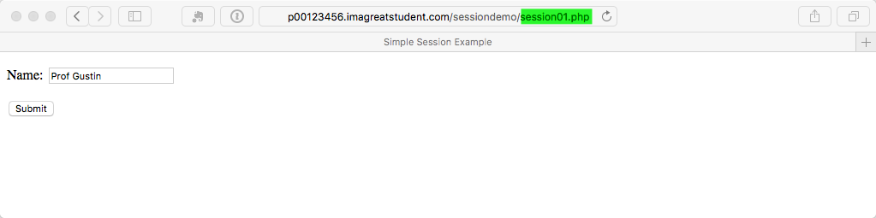
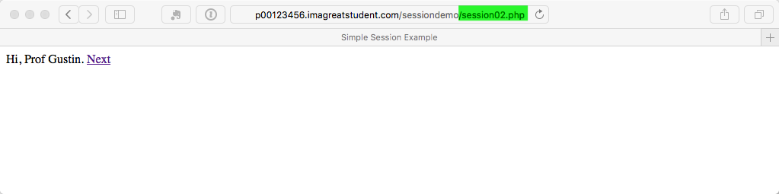
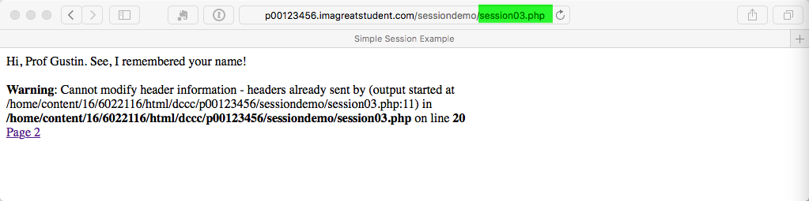

Slide 17
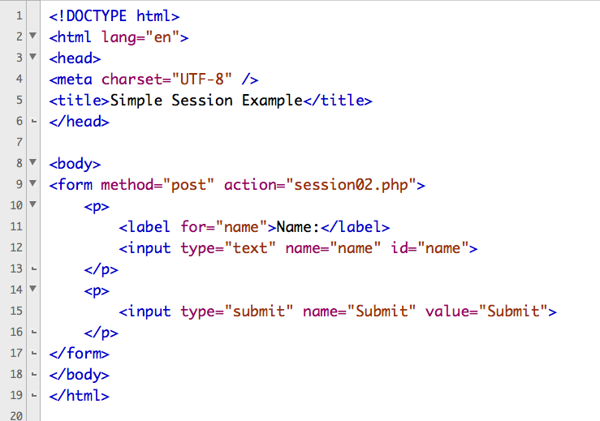
sesson01.php

Slide 18
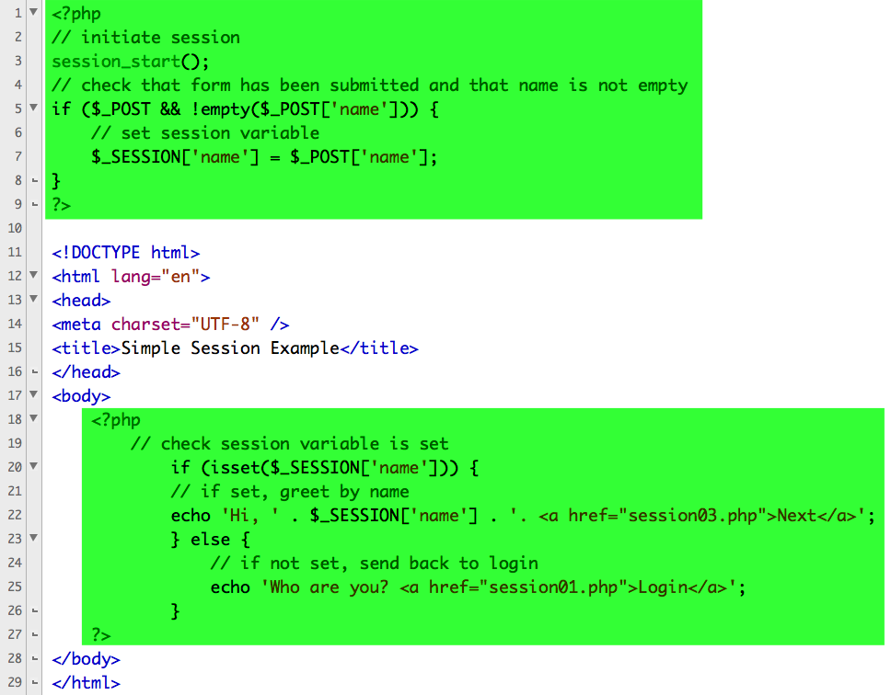
sesson02.php

Slide 19
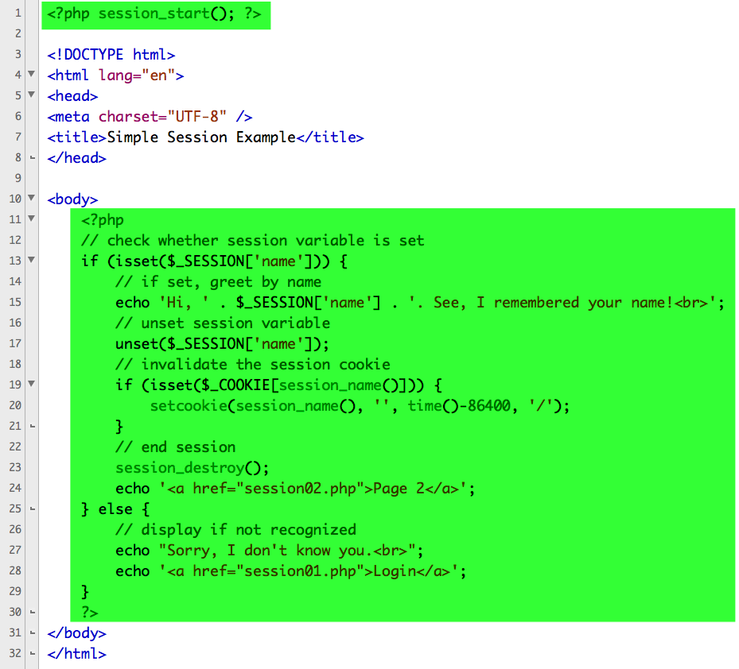
sesson03.php

Slide 20
Why the warning?
We saw this before in our first cookie script.

Slide 21
headers already sent… error message
Handful of functions that can only be called if nothing has been sent to the browser.
header()
setcookie()
session_start()

Slide 22
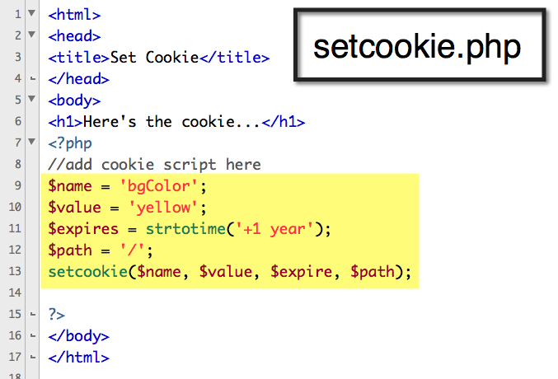

Slide 23
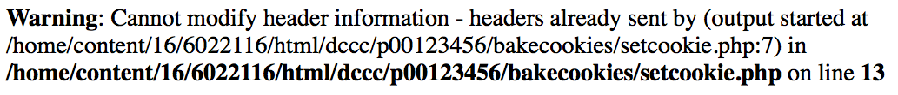
headers already sent… error message
They must be sent from the server to the client prior to any other information.
Should the server attempt to send a cookie after the browser has already received HTML—even an extraneous white space—an error message will result and the cookie will not be sent

Slide 24
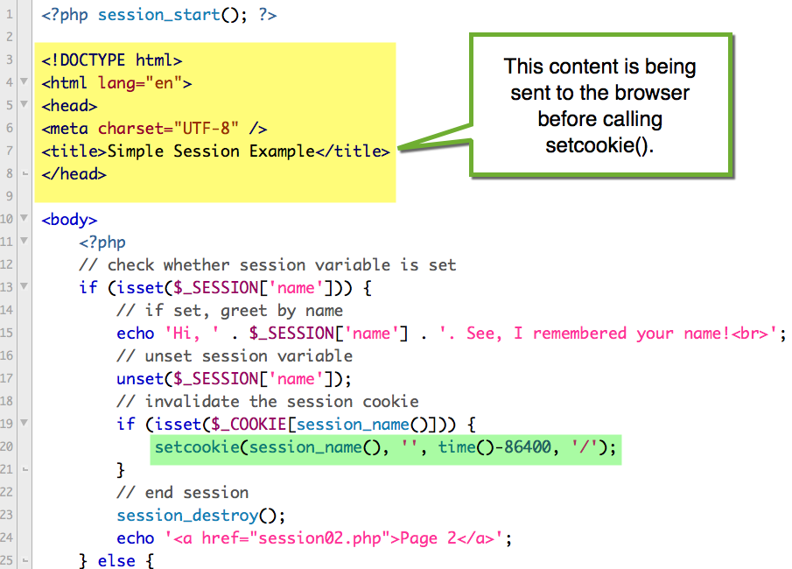
setcookie() is the problem

Slide 25
Solutions?
Put the setcookie() call in the PHP block before the DOCTYPE declaration.
Then you need to assign the value of $_SESSION[‘name’] to an ordinary variable because it ceases to exist after the session is destroyed.
Delete the html code. But that’s not good form.
And, what if you couldn’t move setcookie() for some reason?

Slide 26
Output Buffering
AKA output control
In normal PHP scripts any HTML outside of the PHP tags is immediately sent to the browser.
Also true of print statements.
Output buffering holds the HTML and printed data it put in a buffer and sent to the browser when you decide.

Slide 27
ob_start() and ob_end_flush()
Put ob_start() at the top of your script.
Prevents output from being sent to the browser until the end of the script or you use ob_end_flush()
Once called, every print and similar function will send data to a memory buffer.
At the end of the script call the ob_end_flush()

Slide 28
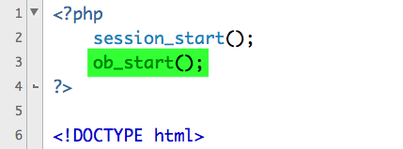
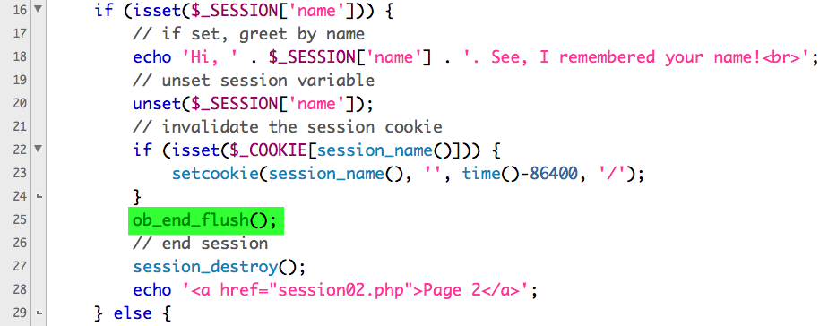
session03.php

Slide 29
URL encoding and sessions
Used to provide session tracking when cookies are disabled.
Stores the session ID in the URL for each page. Not recommended.
Security hold that allows session hijacking.
Site malfunctions if user bookmarks a page with a session ID that will be destroyed.
Causes problems with the way web pages appear in search engines.
http://www.php.net/manual/en/session.idpassing.php

Slide 30
Session Hijacking
If malicious user Alice can learn user Bob’s session ID, Alice can easily trick a server into thinking that Bob’s session ID is also Alice’s session ID.
At that point, Alice would be riding the coattails of Bob’s session and would have access to Bob’s data.
Storing the session ID in a cookie makes it somewhat harder to steal.

Slide 31
Session Fixation
Another type of session attack.
Opposite of session hijacking.
Instead of malicious user Alice finding and using Bob’s session ID, she creates her own session ID (perhaps by logging in legitimately).
Then Alice gets Bob to access the site using that session.
The hope is that Bob would then do something that would unknowingly benefit Alice.

Slide 32
Preventing Session Fixation
Change the session ID after a user logs in.
Regenerating a new session ID can help prevent session hijacking.
session_regenerate_id() provides a new session ID to refer to the current session data.
This technique is used on sites where security must be high – ecommerce, online banking

Slide 33
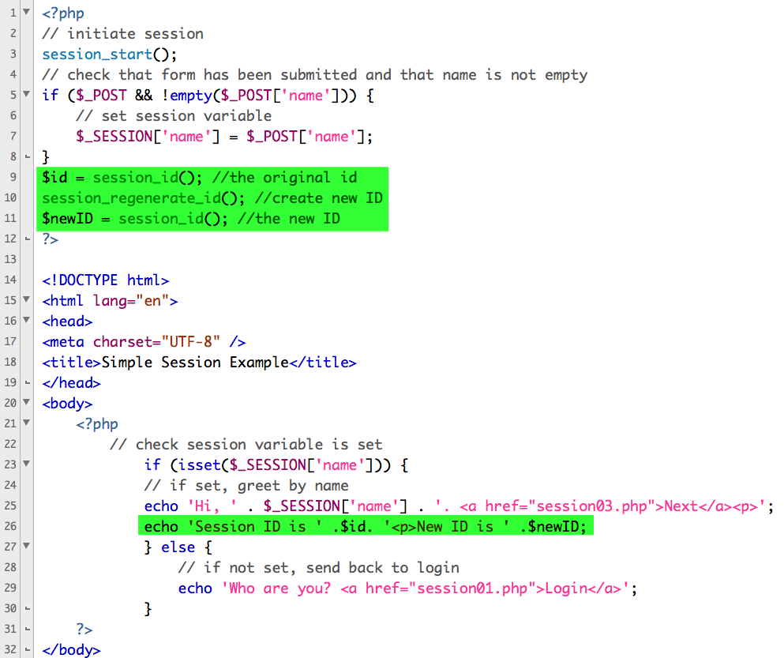
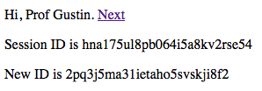
session02.php

Slide 34
Setup the Contacts Authentication
Update index.html to link to authsessions.php instead of authcookies.php
Update header.php to link to authsessions.php
Create admin_login.php
Update authsessions.php to use sessions.
Update the following pages to use admin_login.php:
showcontacts.php
updateform.php
update.php
confirmdelete.php
delete.php

Slide 35

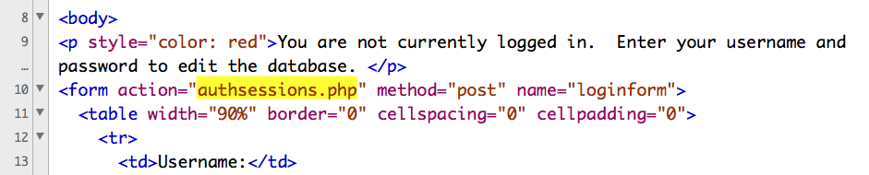
Update index.html to link to authsessions.php

Slide 36

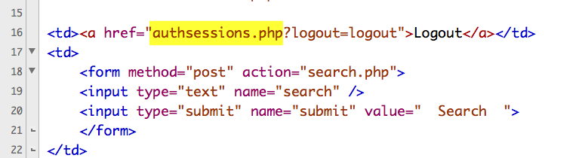
Update header.php to link to authsessions.php

Slide 37

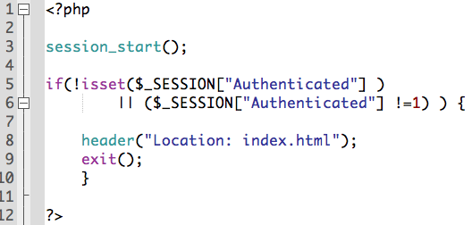
Create new: admin_login.php

Slide 38

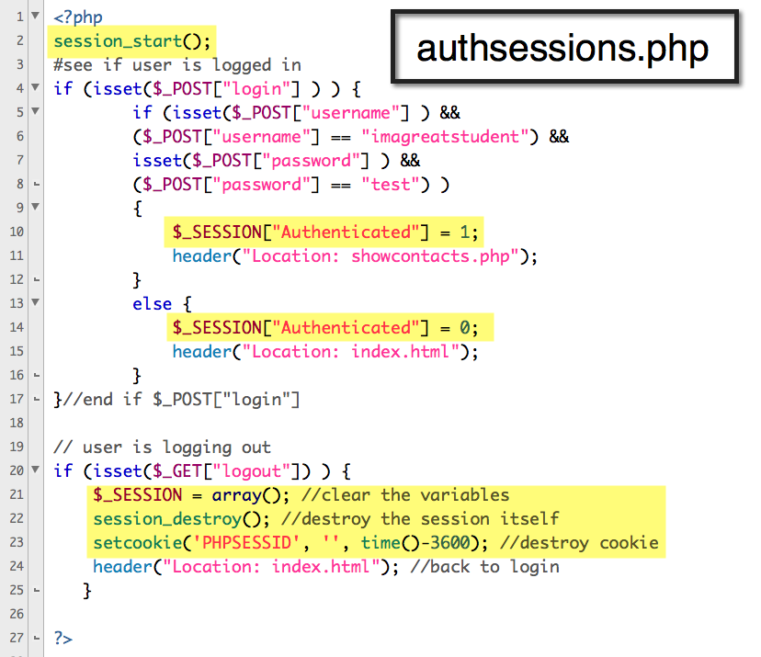
Update authsessions.php to use sessions.

Slide 39

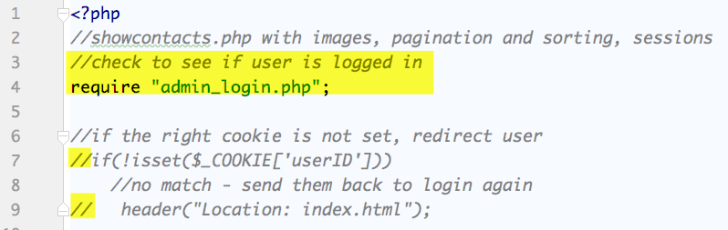
update showcontacts.php

Slide 40
update other php files that should restrict access

